Slide 1

Micro-Credit Defaulter
Submitted by:
Akash Kanjwani

Slide 2
ACKNOWLEDGMENT
During the process of completing this project, I have referred following materials for which I owe them great gratitude.
Data collection- Using Web scraping tool i.e. Selenium
Car24.com for collecting the data easemytrip.com/
Data trained video tutorials.
Scikit-learn https://scikit-learn.org/stable/
Machine Learning for Dummies by John Mueller and Luca Massaron - Easy to understand for a beginner book.
Geeksforgeeks. https://www.geeksforgeeks.org/
Besides that all the observation, creations of the models and graphs done by self help.

Slide 3
Problem Statement:
A Microfinance Institution (MFI) is an organization that offers financial services to low income populations. MFS becomes very useful when targeting especially the unbanked poor families living in remote areas with not much sources of income. The Microfinance services (MFS) provided by MFI are Group Loans, Agricultural Loans, Individual Business Loans and so on.
Many microfinance institutions (MFI), experts and donors are supporting the idea of using mobile financial services (MFS) which they feel are more convenient and efficient, and cost saving, than the traditional high-touch model used since long for the purpose of delivering microfinance services. Though, the MFI industry is primarily focusing on low income families and are very useful in such areas, the implementation of MFS has been uneven with both significant challenges and successes.
Today, microfinance is widely accepted as a poverty-reduction tool, representing $70 billion in outstanding loans and a global outreach of 200 million clients.
We are working with one such client that is in Telecom Industry. They are a fixed wireless telecommunications network provider. They have launched various products and have developed its business and organization based on the budget operator model, offering better products at Lower Prices to all value conscious customers through a strategy of disruptive innovation that focuses on the subscriber.
They understand the importance of communication and how it affects a person’s life, thus, focusing on providing their services and products to low income families and poor customers that can help them in the need of hour.
They are collaborating with an MFI to provide micro-credit on mobile balances to be paid back in 5 days. The Consumer is believed to be defaulter if he deviates from the path of paying back the loaned amount within the time duration of 5 days. For the loan amount of 5 (in Indonesian Rupiah), payback amount should be 6 (in Indonesian Rupiah), while, for the loan amount of 10 (in Indonesian Rupiah), the payback amount should be 12 (in Indonesian Rupiah).
The sample data is provided to us from our client database. It is hereby given to you for this exercise. In order to improve the selection of customers for the credit, the client wants some predictions that could help them in further investment and improvement in selection of customers.
Analytical Problem Framing
Mathematical/ Analytical Modelling of the Problem

Slide 4
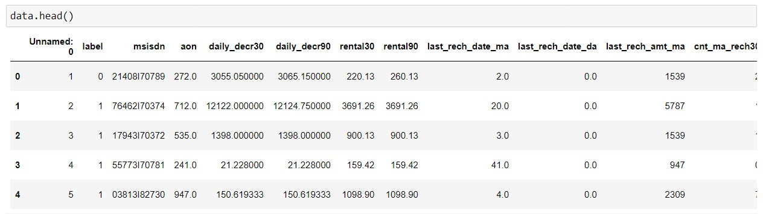
The size of table is 209593* 36 i.e. no. of rows are 209593 and no. of columns are 36(including target).
Out of 36 columns 3 columns are object type in nature and rest 33 are numeric type.
Null values are not present in the data set as we can see in ths seaborn heatmap so there is no need to adopt imputation technique.
In case of object data type, we will apply the encoding technique to convert the values in the numeric format
In our data set all the columns have outliers as we can see, In all the columns the diffrence between mean and standard deviation is very high and the gap between standard deviavtion and the max values is also very high, It shows that the outliers are present in most of the colunms.
In the above dataset most of the columns has skewness : High skewness represents data imbalancy.
Less skewness represents that our data are equally distributed.
If we see the skewness in our data set then we will find that our most of the colunm's data are skewed.This is because of mean is greater than median in most of the colunms.
Data Sources and their formats
Data has been provided by the Flip Robo technology

Slide 5
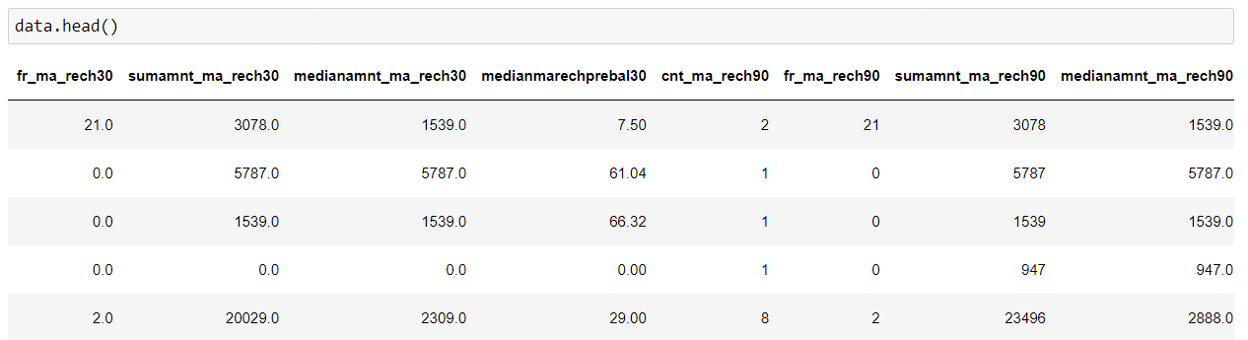
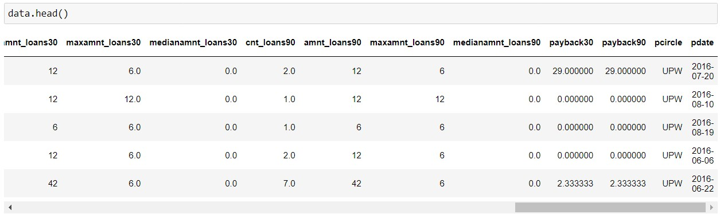
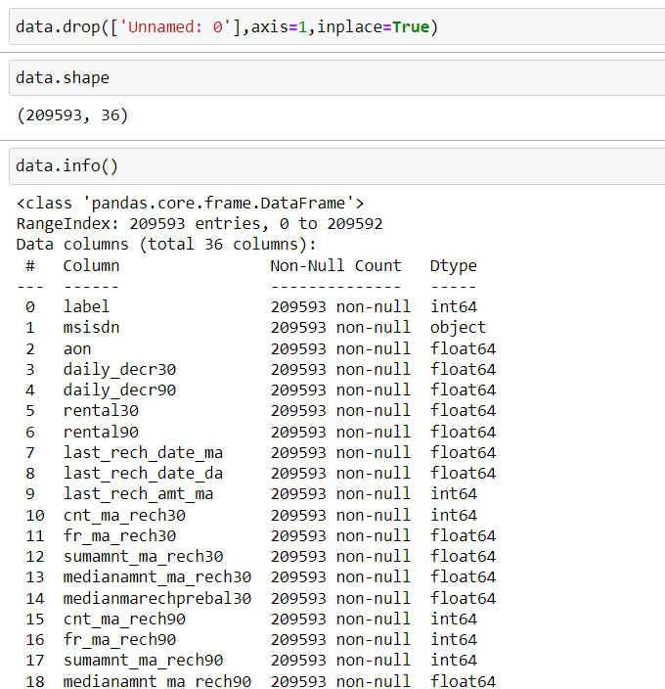

Slide 6
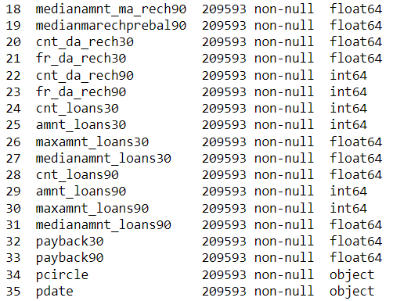
Data Pre-processing Done
Outliers, Skewness, Data scaling, Data Cleaning
Because we had categorical data and absence of numerical data that is why there was no column which can contain outliers and skewness only we had one column i.e. price column, which is numerical in
nature but here we can not pre-process column.
For Data scaling we used Standard scaler.
Data cleaning using pandas function
the target
Scaling the data

Slide 7
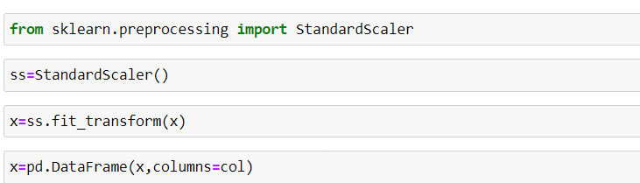
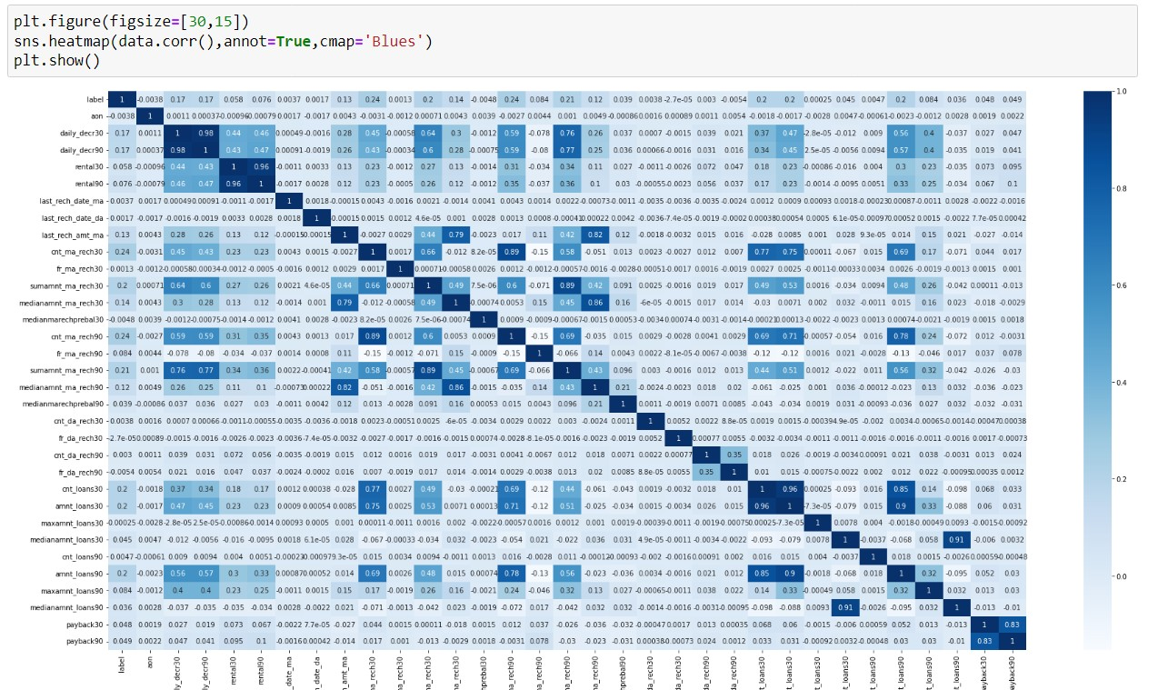
Data Inputs- Logic- Output Relationships

Slide 8
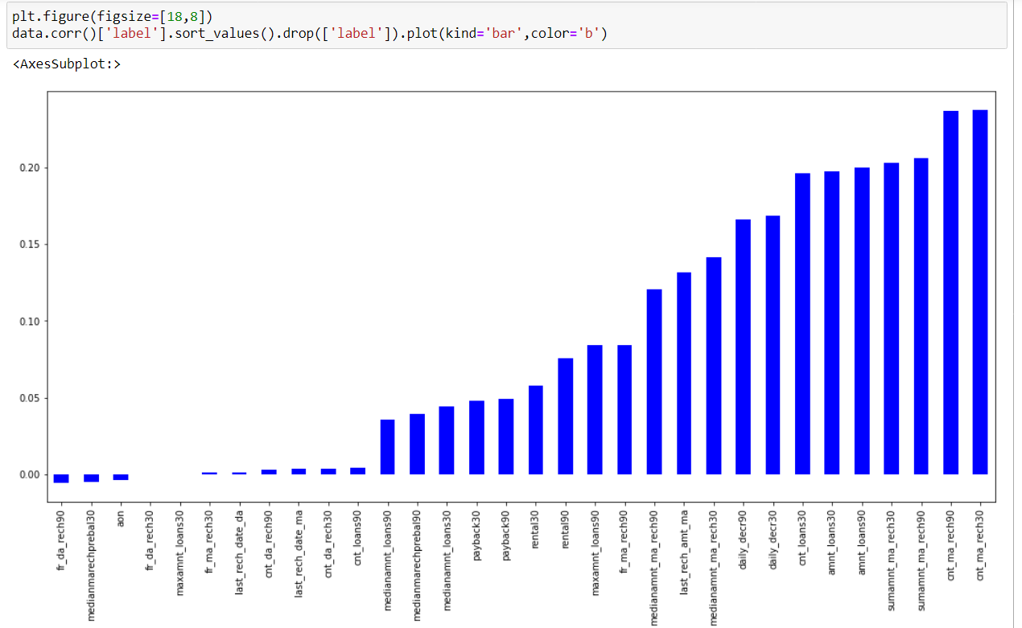
Hardware and Software Requirements and Tools Used Anaconda Navigator
Jupyter Notebook Language-Python Selenium
Many lib.------- import pandas as pd
import matplotlib.pyplot as plt import seaborn as sns
import numpy as np import warnings import selenium
warnings.filterwarnings('ignore')
from sklearn.preprocessing import power_transform from scipy.stats import zscore
from sklearn.preprocessing import MinMaxScaler

Slide 9
import statsmodels.api as si
from scipy import stats from statsmodels.stats.outliers_influence import sklearn
from sklearn.linear_model import LinearRegression,Lasso,Ridge,ElasticNet
from sklearn.model_selection import train_test_split,GridSearchCV,cross_val_score from sklearn.tree import DecisionTreeRegressor
from sklearn.svm import SVR
from sklearn.neighbors import KNeighborsRegressor from sklearn.ensemble import
RandomForestRegressor,AdaBoostRegressor,GradientBoostingRegressor
import xgboost as xg from sklearn.metrics
import mean_squared_error,mean_absolute_error,r2_score Pandas- For making data frame
Matplotlib and seaborn- For data visualization Numpy- For numerical python
MInMAxScaler- For data scaling
Power transform-For removing skewness
From metrice - mean_squared_error,mean_absolute_error,r2_score -For checking the model accuracy.
Regression- For regression modeling Ensamble- For boosting and bagging
Grid search cv- For hyperparameter tuning
Cross_Val_Score- For cross validation
Model/s Development and Evaluation
Approaches Firstly it is import to know about which type of modelling we are going to construct, For this problem we used regression models because our target variable is numerical type and we had to predict the flight price. When we go for regression we have to use some metrics like mean_squared_error, mean_absolute_error, r2_score In order to do this work we have to find out the best random state by which we can achieve good accuracy. Then we split our data set into the train part and test part using train test split. When we

Slide 10
done with the modelling we have to use cross validation for real accuracy(without underfitting and overfitting). Hyperpameter is must for increasing the model accuracy in order to build good model for this we use Grid search cv. We followed all the above approaches to build our Machine learning model.
Model learning phase
So basically it will become important to know which type of machine learning model we are going to construct.It depends on the target. Here we are going to use classification model because our target column is catagorical in nature.
For classification model, Some matrix we are going to find like:
Confusion matrix
Accuracu Score
Classification report
Models:
Decision Tree classifier KNeighbors classifier
Support vectod machine classifier Naive bayes classifier
For bagging and boosting :
Random Forest classifier AdaBoost classifier Gradient Boosting classifier XGboost classifier

Slide 11
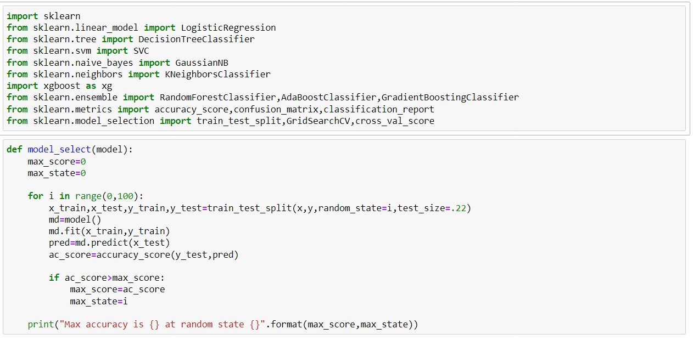
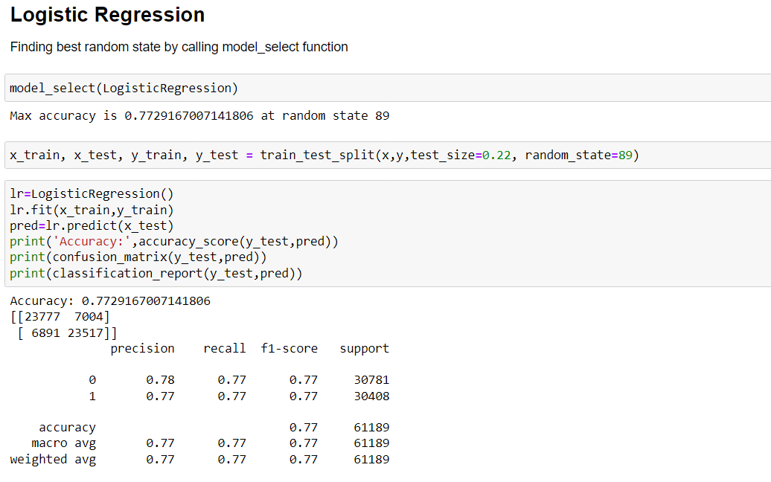

Slide 12
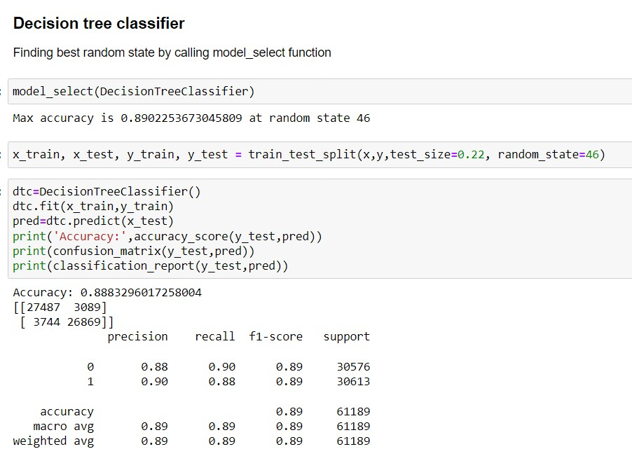
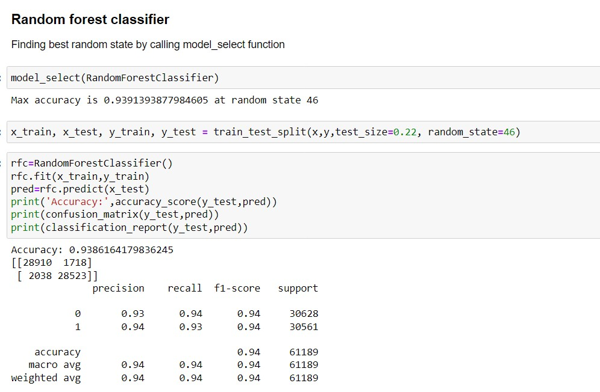

Slide 13
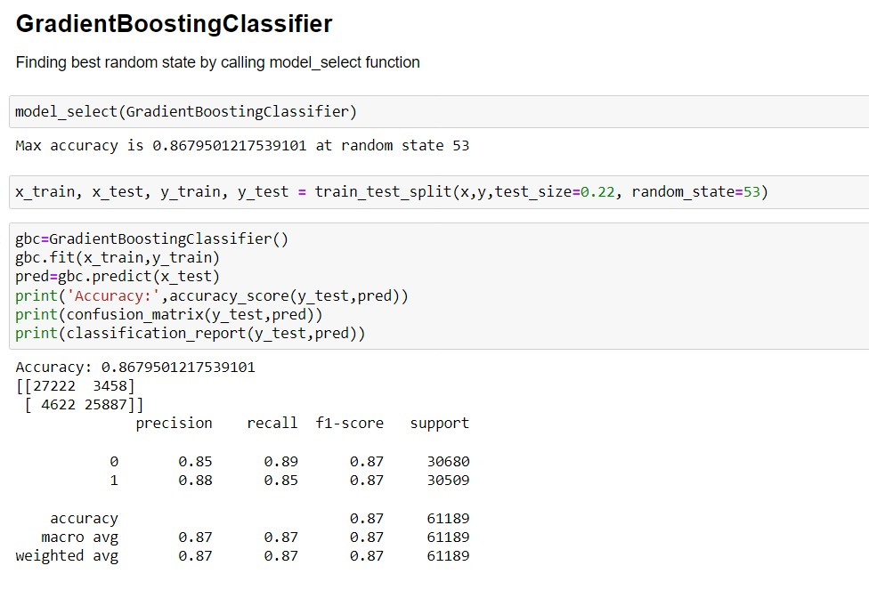
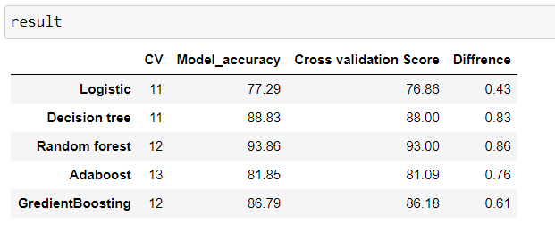

Slide 14
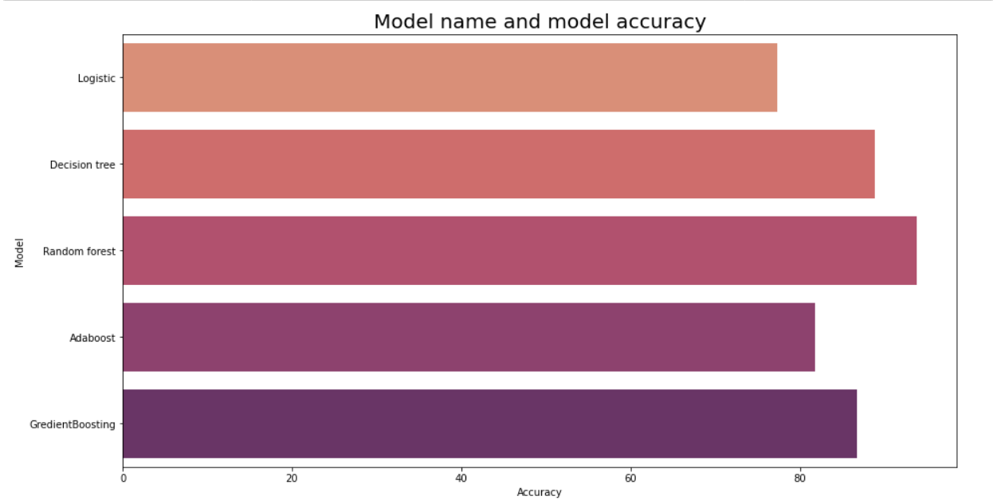
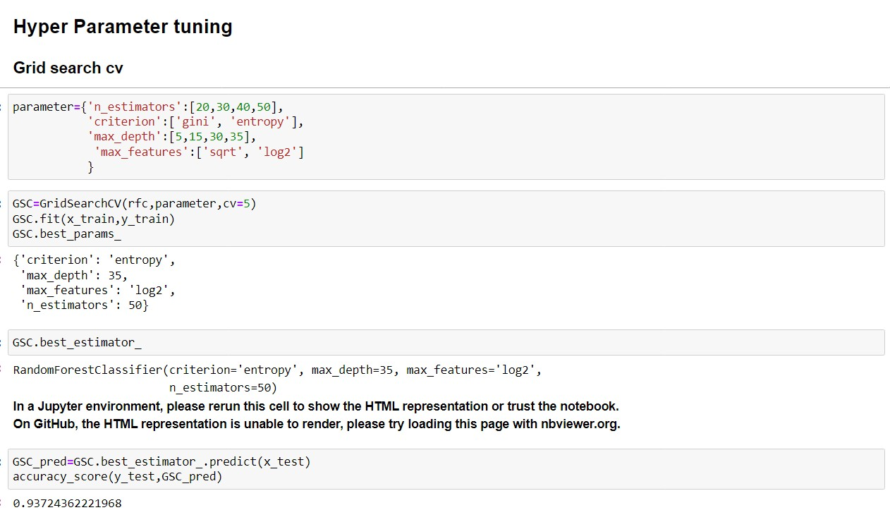

Slide 15
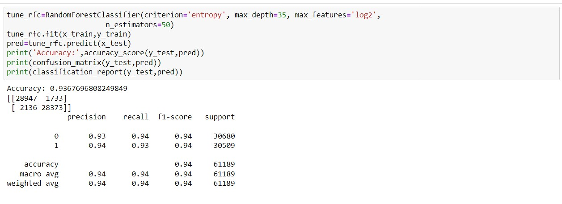
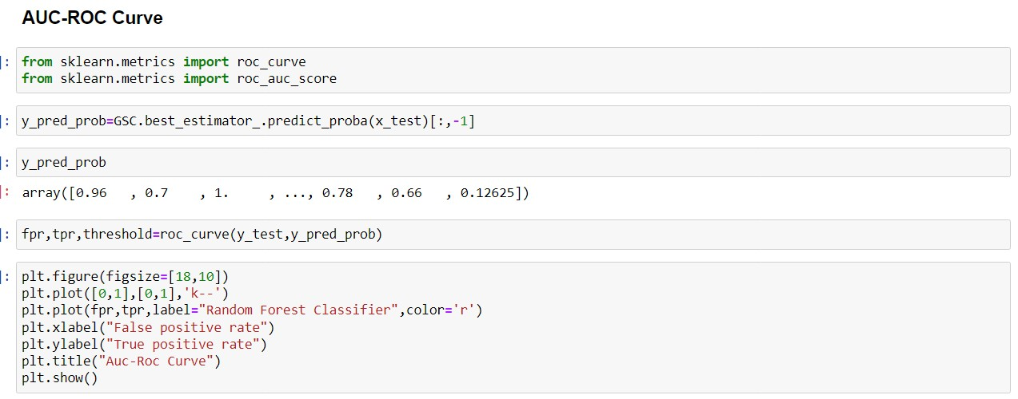
Best Model
We are chosing Random forest classifier as a best model, Because this model has least diffrence between model acuracy score and cross validation score and also its accuracy is highest as compare to others.That is why we are choosing RFC
Model accuracy is : 93.86
Cross_validation score : 93 Diffrence : 0.86

Slide 16
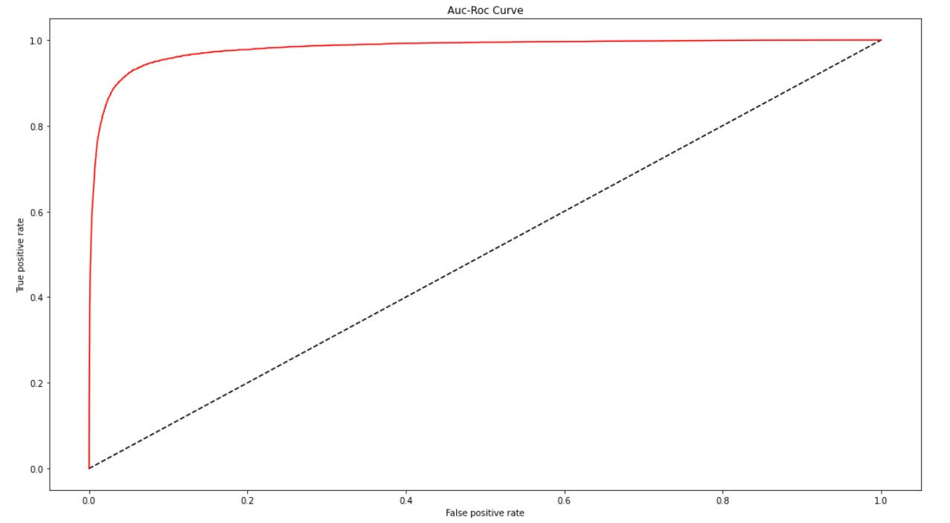

Slide 20
